Slide 1
The global perspectives in the future of mental health promotion
Mari Lahti
PhD, Post Doc researcher,
Principal lecturer
Turku University of Applied Science,
University of Turku

Slide 2
Glossary of terms
Mental health: Mental health is a state of well-being in which an individual realizes his or her own abilities, can cope with the normal stresses of life, can work productively and is able to make a contribution to his or her community.
Mental disorders: Mental disorders comprise a broad range of problems, with different symptoms. However, they are generally characterized by some combination of abnormal thoughts, emotions, behaviour and relationships with others. These disorders are included and described in chapter V: Mental and behavioural disorders (FOO-F99) of WHO's International Statistical Classification of Diseases and Related Health Problems 10th Revision (lCD-l 0). (Also to notice that globally DSM-5 is widely used for diagnostic tool)
WHO, 2013

Slide 3
Glossary of terms
Disability: Disability is an umbrella term for impairments, activity limitations and participation restrictions, denoting the negative aspects of the interaction between an individual (with a health condition) and that individual's contextual factors (environmental and personal factors).
Psychosocial disabilities: Refer to people who have received a mental health diagnosis, and who have experienced negative social factors including stigma, discrimination and exclusion. People living with psychosocial disabilities include ex-users, current users of the mental health care services, as well as persons that identify themselves as survivors of these services or with the psychosocial disability itself.
WHO, 2013

Slide 4
Glossary of terms
Recovery: From the perspective of the individual with mental illness, recovery means gaining and retaining hope, understanding of ones abilities and disabilities, engagement in an active life, personal autonomy, social identity, meaning and purpose in life and a positive sense of self. Recovery is not synonymous with cure. Recovery refers to both internal conditions experienced by persons who describe themselves as being in recovery - hope, healing, empowerment and connection - and external conditions that facilitate recovery - implementation of human rights, a positive culture of healing, and recovery-oriented services.
WHO, 2013

Slide 5
Let’s see one short video about why we need to focus on global mental health?
https://www.worldbank.org/en/topic/mental-health

Slide 7
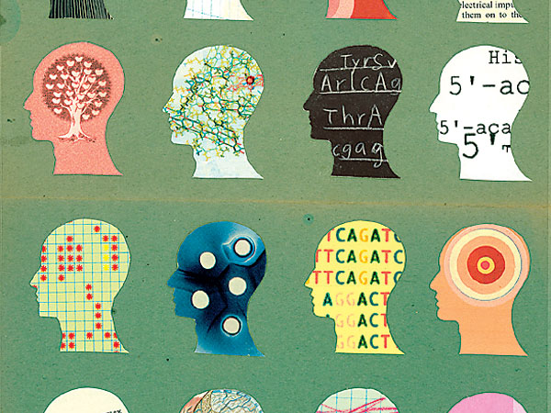
Must know global mental health strategies

Slide 8
WHO – Mental health action plan 2013-2020
Objective 1: To strengthen effective leadership and governance for mental health
Objective 2: To provide comprehensive, integrated and responsive mental health and social care services in community-based settings
Objective 3: To implement strategies for promotion and prevention in mental health
Objective 4: To strengthen information systems, evidence and research for mental health

Slide 10
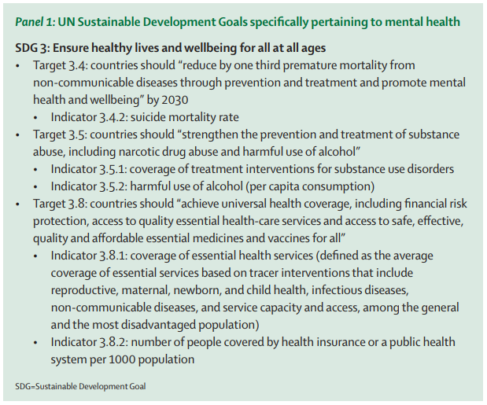

Slide 11
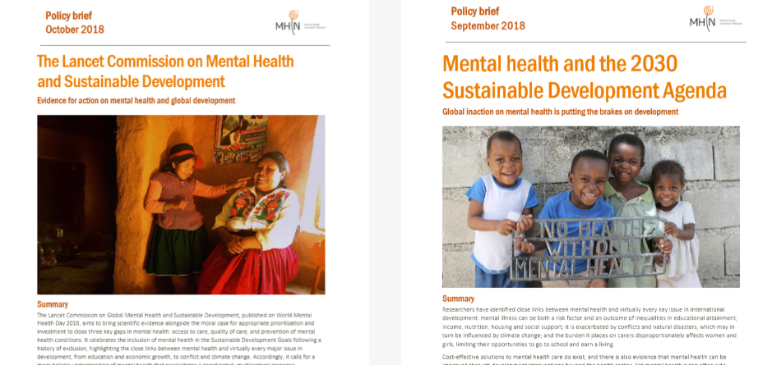
READ MORE: https://www.thelancet.com/commissions/global-mental-health

Slide 12
Let’s see a short video from Lancet commission…
https://globalmentalhealthcommission.org/overview-film/

Slide 14
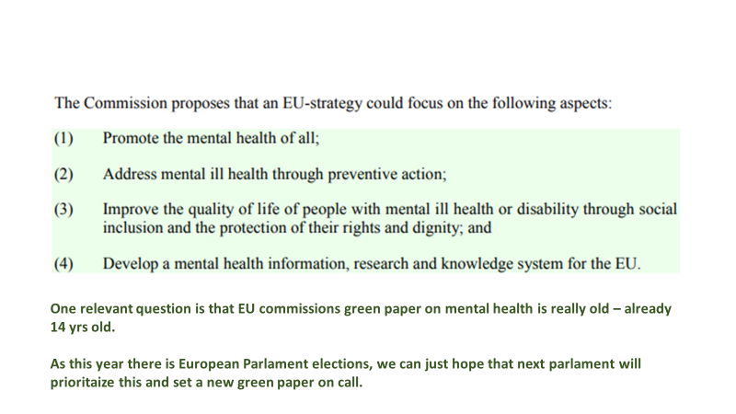
European Commission, 2005

Slide 15
List of interesting references and links
https://www.worldbank.org/en/topic/mental-health
https://globalmentalhealthcommission.org/
https://www.who.int/violenceprevention/en/
http://documents.worldbank.org/curated/en/950821542885406030/pdf/132340-WP-PUBLIC-21-11-2018-12-36-2-WBGMHScalingResponsewebfinal.pdf
https://www.who.int/mental_health/action_plan_2013/en/

